Slide 1
Algorithm Analysis:Outline
Faster RCNN
RCNN review
Fast RCNN review
Faster RCNN
RetinaNet
Model Architecture
Focal Loss
Ensemble
Large and small size objects
Results

Slide 2
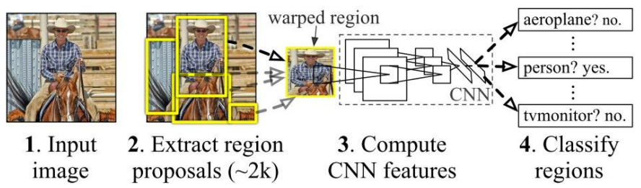
Faster RCNN
RCNN Architecture Review: Background
In 2014 a new CNN-based object detection algorithm, called RCNN was proposed to improve the object detection performance. Like its previous approaches, RCNN follows the same object detection pipeline, which involves the following steps:
Extract region proposals directly from the input image (e.g., selective search).
Compute the features of each proposal.
Classify the proposals (SVM)

Slide 3
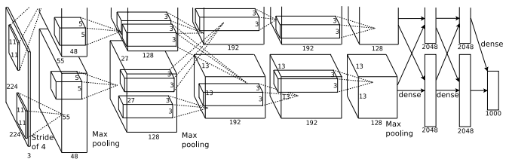
Faster RCNN
RCNN Architecture Review: Contribution
The main contribution in the RCNN algorithm is the use of a CNN-based model architecture to extract the features from the input regions.
The architecture was proposed by Alex Krizhevsky et al.* and it is composed of 5 convolutional layers and 3 fully connected layers.
* ImageNet Classification with Deep Convolutional Neural Networks

Slide 4
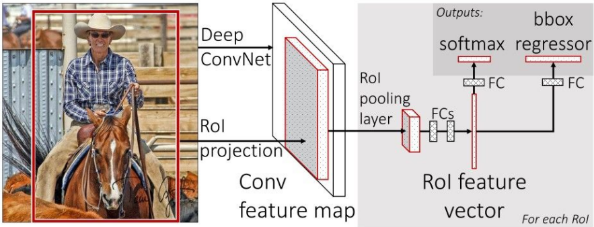
Faster RCNN
Fast RCNN Architecture Review: Contribution
Fast RCNN was proposed to tackle the problem of high latency and memory consumption found in RCNN. The authors introduced a new technique called ROI Pooling, that eliminates the need of running multiple forward operations to classify the generated regions in the input Image.
First the regions of interest (ROI) is projected on the last convolutional feature map, then extra max pooling operation (Roi pooling) and dense layers are added to generate a fixed sized feature vector, which will be then classified.

Slide 5
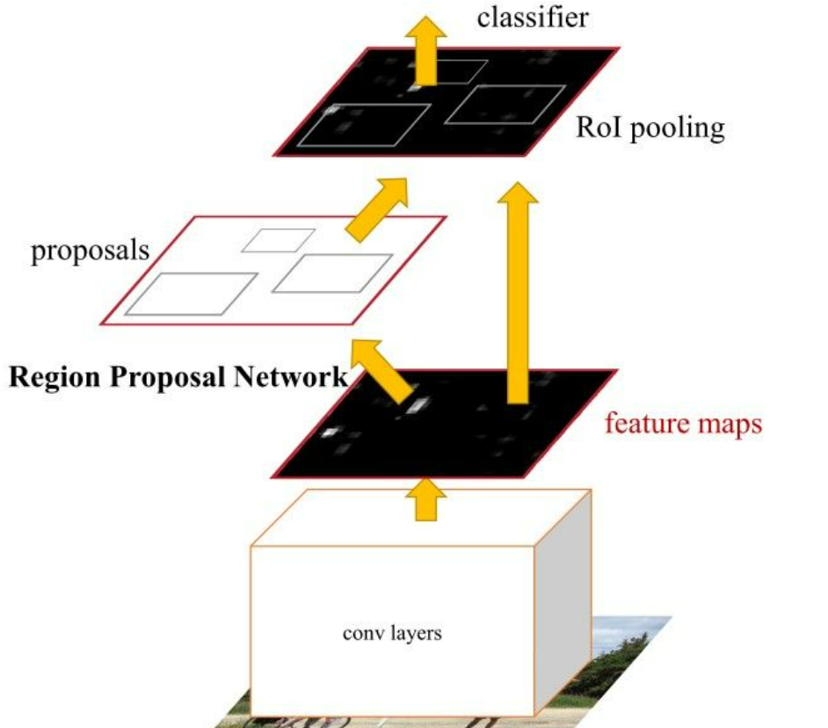
Faster RCNN
Faster RCNN: Algorithm
To be able to detect the objects in the input image RCNN and Fast RCNN use similarity-based methods to generate the region proposals. These, methods are usually slow and not learnable which make them unable to adapt to different type of input. To fix this, in Faster RCNN the authors propose a Region Proposal Network (RPN): a convolutional neural network that can be trained to generate proposals with more accuracy.

Slide 6
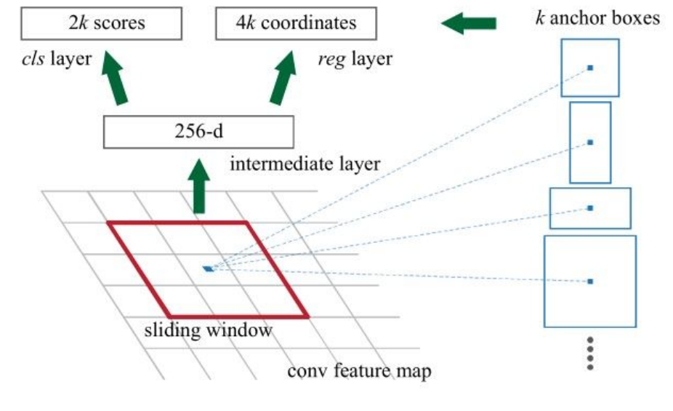
Faster RCNN
Faster RCNN: Contribution
The Region Proposal Network take as an input multiple anchor boxes with different sizes and aspect ratios. An Anchor boxes are reference boxes that are generated for every pixel in the feature map. All the feature map’s regions that correspond to each anchor will be processed through a convolutional layer, then their objectiveness score and object 4 coordinates are obtained using 1*1 convolutional layers.

Slide 7
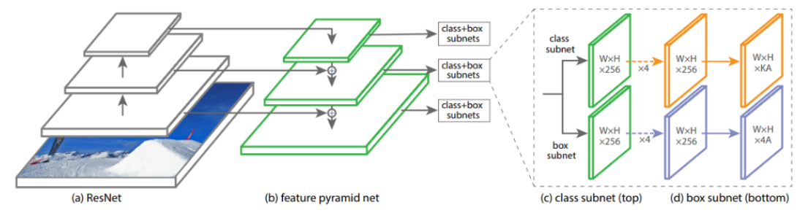
RetinaNet
Architecture: Overview
As we previously discussed the RCNN algorithms use one stage to generate region proposals and another stage to make predictions out of them. In RetinaNet, however, only one stage is used in which no region proposal algorithm is used, instead anchor boxes are directly generated from the input image and a neural network is used to predict the object classes with their locations (4 coordinates).

Slide 8
RetinaNet
Architecture: Feature Pyramid Network
In the RetinaNet architecture Resnet model is used as a backbone to extract multi-scale features from the input. These multi-scale features map are then fed to another neural network in such way every feature map from every scale has lateral connections with a top-down pathway.

Slide 9
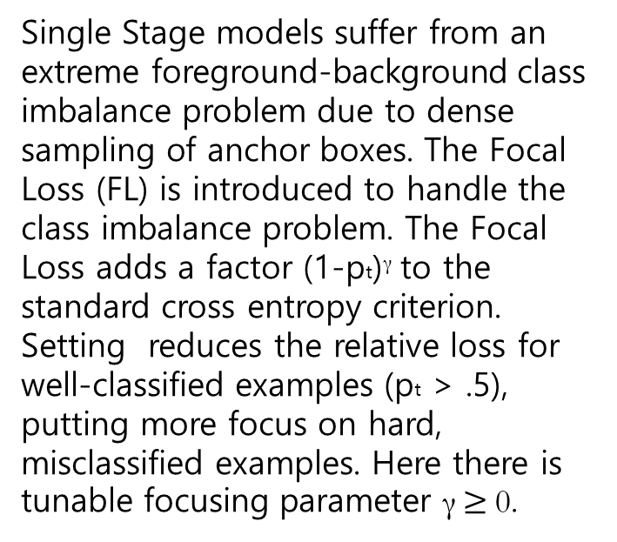

RetinaNet
Architecture: Focal Loss

Slide 10
Ensemble
Results Interpretation
My hypothesis is that some models are good at detecting small objects and others are better in predicting large size objects. So, If we can combine the pros of the two, then we will definitely get better performance than both type of models.
To achieve this, I tried to find example of models where the tradeoff of performance between APs and APl can be seen. By considering only the small objects predictions of one model and the large size objects predictions of another, the resulting AP should be higher than the two models. In other words, if we can transfer the APl results of RCNN model to the Retina model results, then the resulting AP will increase.
AP = 0.404 -> 0.405
APl = 0.522 -> 0.527

